Slide 1

Berkeley Police Stop Data
Amy Zhu, Mengyu Li, Rebecca Reus, and Shangjun Jiang

Slide 2
Why I chose this area of science
First, it’s Berkeley local data. Go Bears!!!
Stop/ Arrest/ Jail Book/ Call for service data reals different aspects of Berkeley safety condition. It’s one of the factors we care most about Berkeley.

Slide 3
The problem or challenge
What’s the most dangerous place in Berkeley?
What’s the most dangerous time in Berkeley in a day?
Does Berkeley PD has any preference of arresting a specific group during stop?

Slide 4
Stop Data Cleaning
Separate original disposition into number of an individual, race, gender, age range of the individual, enforcement and reason of the stop, car search information and additional dispositions for analysis purpose.
Converting literal address to longitude and latitude for the convenience of drawing maps.

Slide 5
Census Data Cleaning

Slide 6
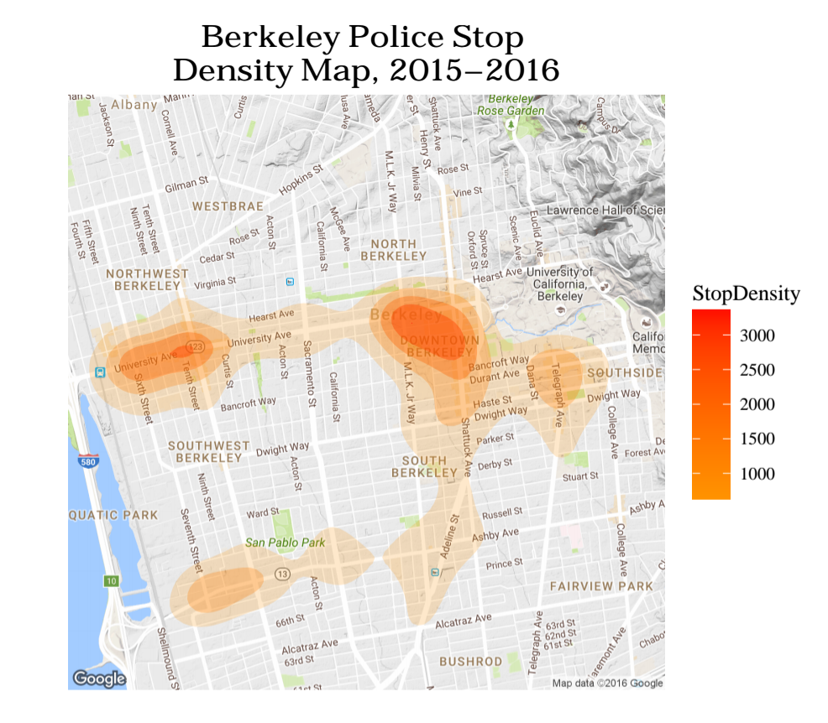
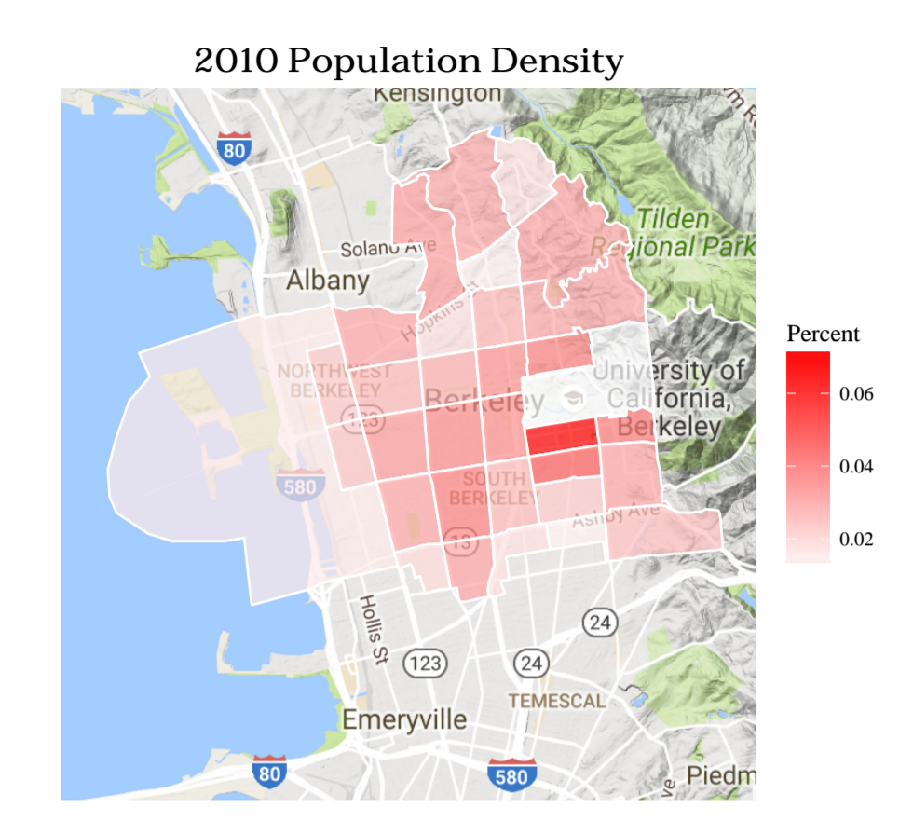
Berkeley PD Stop Density and Population Density

Slide 7
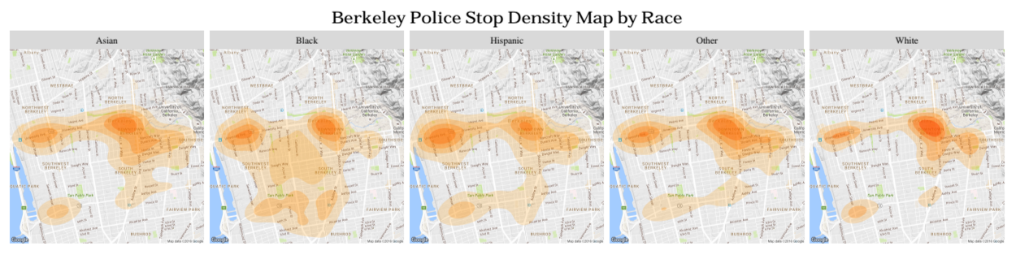
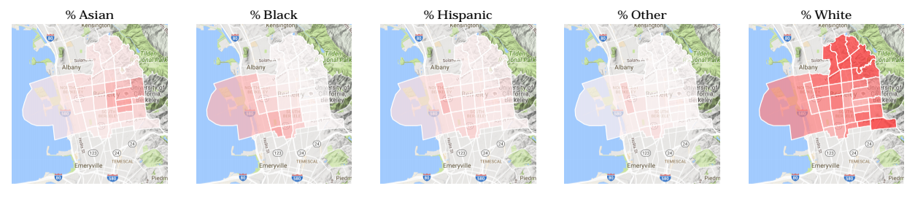
Stop and Population Density by Race

Slide 8
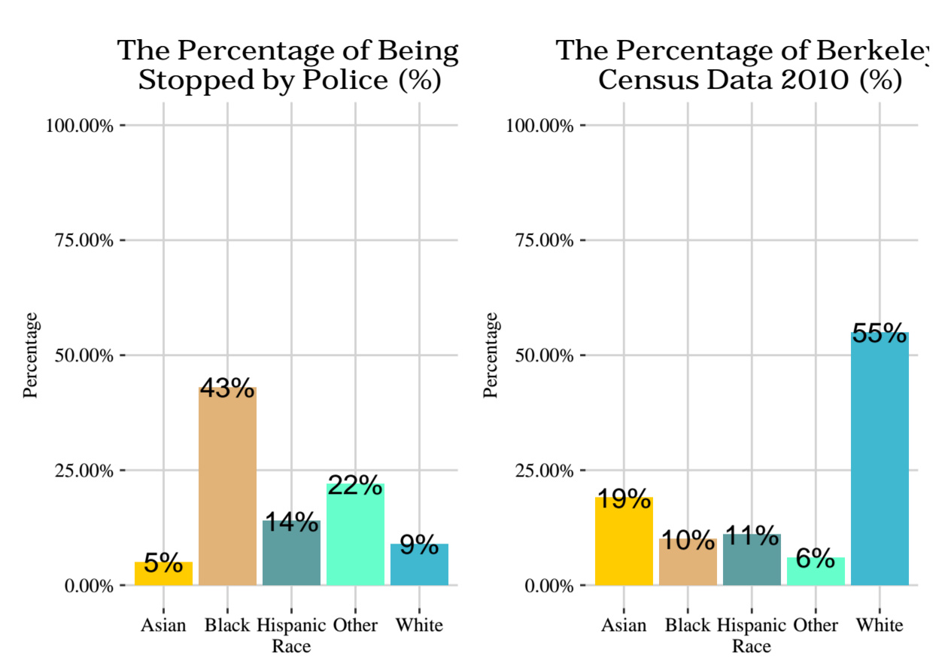
Percent Population Stop Percentage
Conclusions:
Although southside campus has the greatest population density, westside campus has the greatest stop density.
White people contribute the majority to Berkeley population, while Black people are most liable to affected by the stop.
Black people have a larger and sparser range of stop, while other races are more focused.

Slide 9
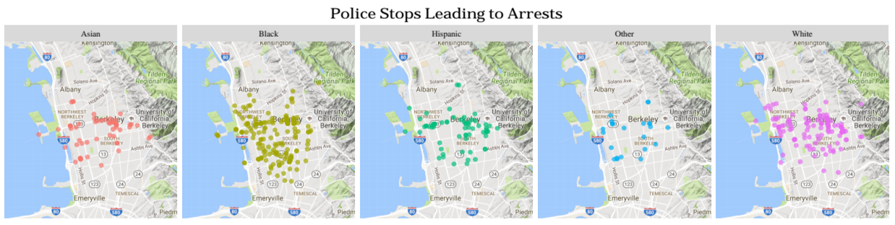
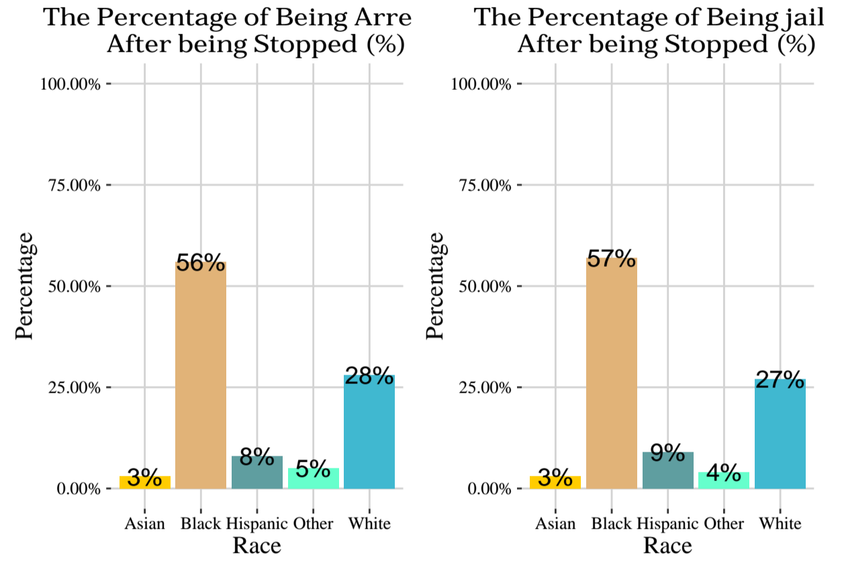
Arrest Ratio
Arrest Analysis
Conclusions:
The majority of people being arrested / jailed are black, while white people also contributes a negligible part.
Asian people contribute lowest percentage of being arrested / jailed. This fact corresponds to the “model minority” stereotype of Asian.
These 2 charts are similar. We can deduce that after Berkeley PD arrests people, it always puts them into the jail.
22

Slide 10
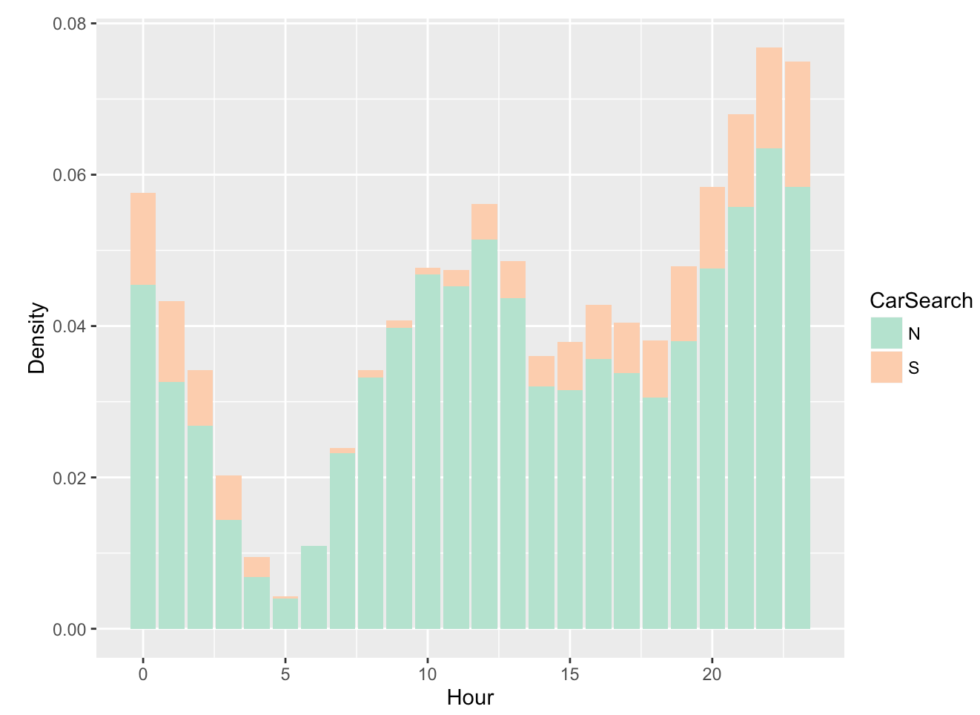
Hour Analysis
Density of Hour in a Day
From evening, incidents density keeps increasing and reaches the highest point in the midnight.
After midnight, incidents density decreases because people need sleep. Incidents density increases in the morning since people start to wake up.
Berkeley PD is more liable to do car search at night.

Slide 11
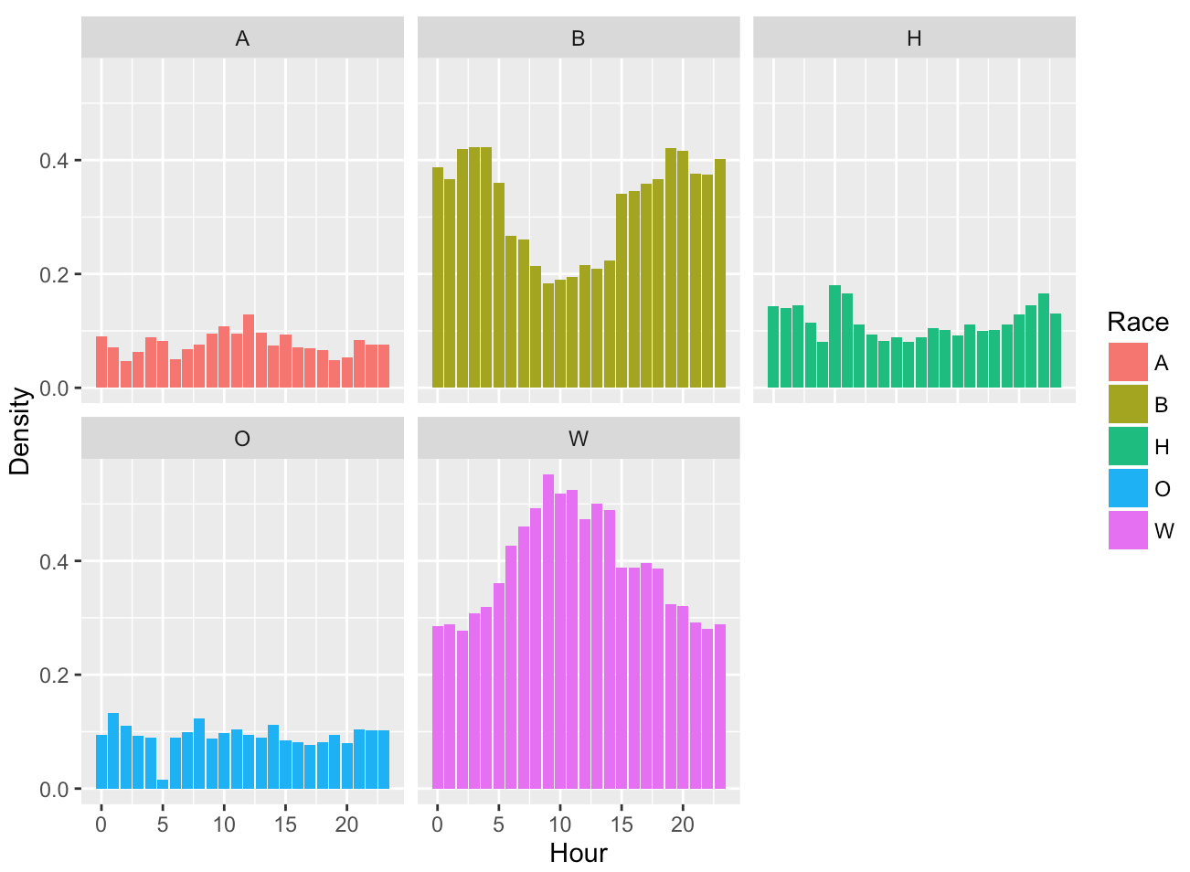
Conclusions:
P(Race | Hour)
Black people are more liable to be stopped at the night.
White people are more liable to commit incidents in the daytime.
Ratios of incidents committed by three other races fluctuate during the daytime and the night, with an average ratio of 8%, 11% and 9% respectively.

Slide 12
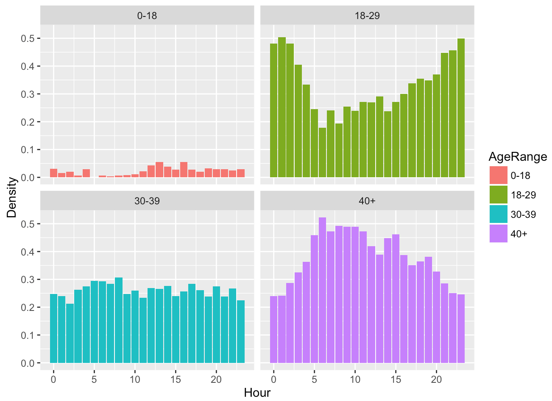
P(Age | Hour)
Conclusion:
People aged from 18 to 29 are obviously liable to commit incidents at night because young people are more likely to stay up to late.
People aged greater than 40 are easier to be stopped in the daytime for they need to participate activities during daytime.
People aged from 0 to 18 contribute the least percentage in any hour.

Slide 13
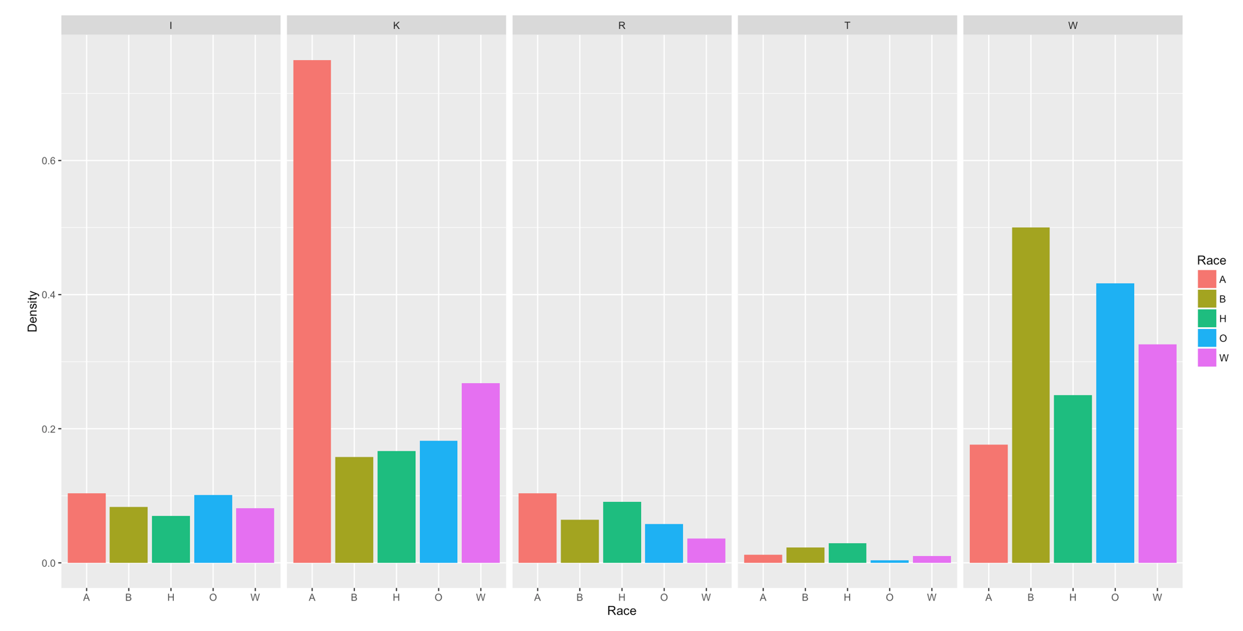
P(Arrested | Reason, Race)

Slide 14
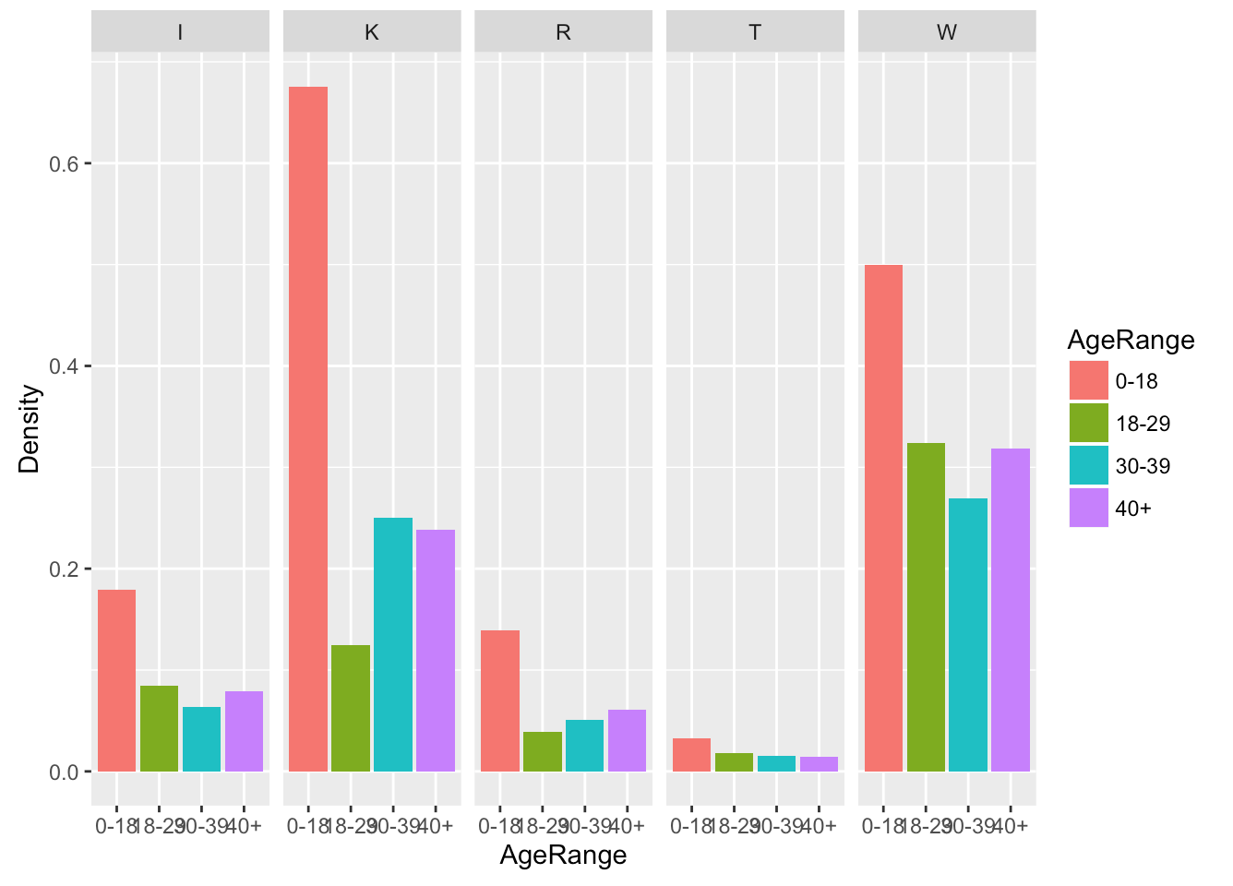
P(Arrested | Reason, Age Range)

Slide 15
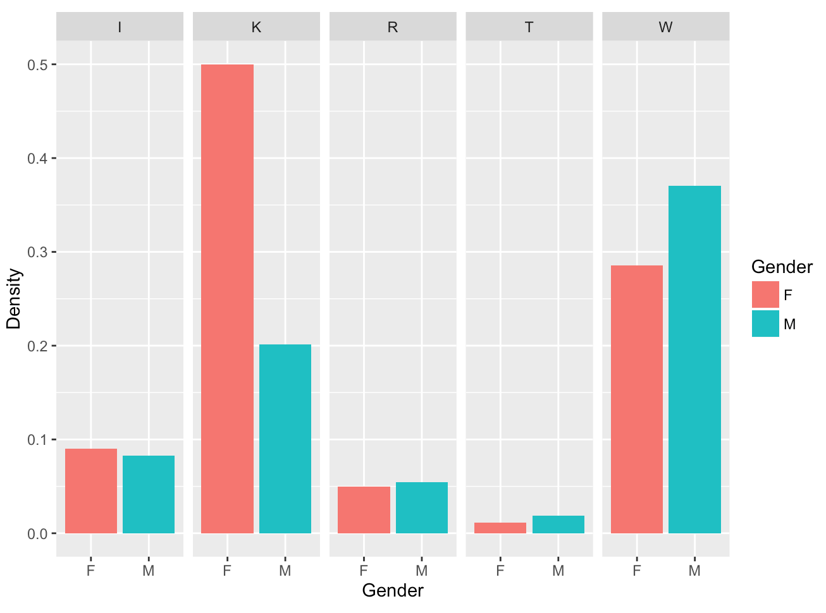
P(Arrested | Reason, Gender)

Slide 16
Conclusion
The probability of arrested in a stop with the reason Traffic is the lowest and wanted is the highest.
An interesting fact is that the conditional probability of arrested in a stop with the reason Probation or Parole of female, Asian people and teenger(0 - 18) is obviously higher than any other group in their own chart.
The conditional probability of arrested given person involved aged from 0 to 18 in a stop given any reason is more than that of given person with any other age range. Therefore, in a stop, teenagers is more liable to be arrested by Berkeley Police Department.

Slide 17

What will we do next?
We can develop applications such as App to provide safety condition about a specific location according to time.

Slide 18
Berkeley Police Stop Data
Amy Zhu, Mengyu Li, Rebecca Reus, and Shangjun Jiang

Slide 19
Why I chose this area of science
First, it’s Berkeley local data. Go Bears!!!
Stop/ Arrest/ Jail Book/ Call for service data reals different aspects of Berkeley safety condition. It’s one of the factors we care most about Berkeley.

Slide 20
The problem or challenge
What’s the most dangerous place in Berkeley?
What’s the most dangerous time in Berkeley in a day?
Does Berkeley PD has any preference of arresting a specific group during stop?

Slide 21
Stop Data Cleaning
Separate original disposition into number of an individual, race, gender, age range of the individual, enforcement and reason of the stop, car search information and additional dispositions for analysis purpose.
Converting literal address to longitude and latitude for the convenience of drawing maps.

Slide 22
Census Data Cleaning

Slide 23
Berkeley PD Stop Density and Population Density

Slide 24
Stop and Population Density by Race

Slide 25
Percent Population Stop Percentage
Conclusions:
Although southside campus has the greatest population density, westside campus has the greatest stop density.
White people contribute the majority to Berkeley population, while Black people are most liable to affected by the stop.
Black people have a larger and sparser range of stop, while other races are more focused.

Slide 26
Arrest Ratio
Arrest Analysis
Conclusions:
The majority of people being arrested / jailed are black, while white people also contributes a negligible part.
Asian people contribute lowest percentage of being arrested / jailed. This fact corresponds to the “model minority” stereotype of Asian.
These 2 charts are similar. We can deduce that after Berkeley PD arrests people, it always puts them into the jail.
22

Slide 27
Hour Analysis
Density of Hour in a Day
From evening, incidents density keeps increasing and reaches the highest point in the midnight.
After midnight, incidents density decreases because people need sleep. Incidents density increases in the morning since people start to wake up.
Berkeley PD is more liable to do car search at night.

Slide 28
Conclusions:
P(Race | Hour)
Black people are more liable to be stopped at the night.
White people are more liable to commit incidents in the daytime.
Ratios of incidents committed by three other races fluctuate during the daytime and the night, with an average ratio of 8%, 11% and 9% respectively.

Slide 29
P(Age | Hour)
Conclusion:
People aged from 18 to 29 are obviously liable to commit incidents at night because young people are more likely to stay up to late.
People aged greater than 40 are easier to be stopped in the daytime for they need to participate activities during daytime.
People aged from 0 to 18 contribute the least percentage in any hour.

Slide 30
P(Arrested | Reason, Race)

Slide 31
P(Arrested | Reason, Age Range)

Slide 32
P(Arrested | Reason, Gender)

Slide 33
Conclusion
The probability of arrested in a stop with the reason Traffic is the lowest and wanted is the highest.
An interesting fact is that the conditional probability of arrested in a stop with the reason Probation or Parole of female, Asian people and teenger(0 - 18) is obviously higher than any other group in their own chart.
The conditional probability of arrested given person involved aged from 0 to 18 in a stop given any reason is more than that of given person with any other age range. Therefore, in a stop, teenagers is more liable to be arrested by Berkeley Police Department.

Slide 34
What will we do next?
We can develop applications such as App to provide safety condition about a specific location according to time.

